Slide 1

Student’s depression Prediction
By Hiba shaito and Mahmoud zahra

Slide 2





introduction
Depression is a common event among children and adolescence, it affects their dietary habits negatively causing them some nutrition problems at times and may even give them suicidal thoughts. Therefore it was required to create a machine learning model in order to predict which student have depression.

Slide 3

DATASET DESCRIPTION
The dataset contains brief description of the student’s conditions and emotions including their age, gender, academic pressure, work pressure, cgpa, study satisfaction, study satisfaction, job satisfaction ,sleep duration ,dietary habits ,degree , suicidal thoughts, work/study hours, financial stress, family history of mental illness and whether they are depressed or not.

Slide 4
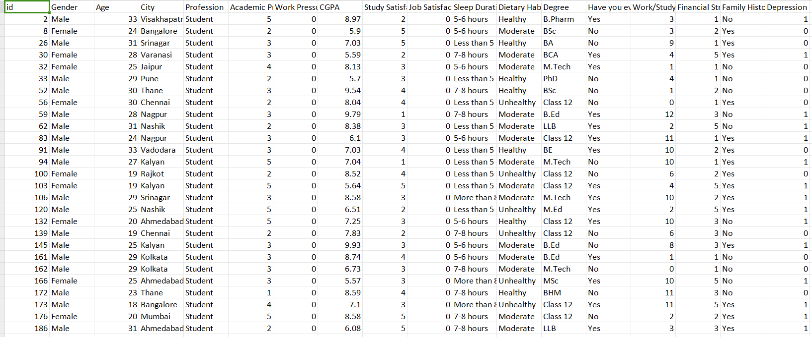
Dataset overview

Slide 5
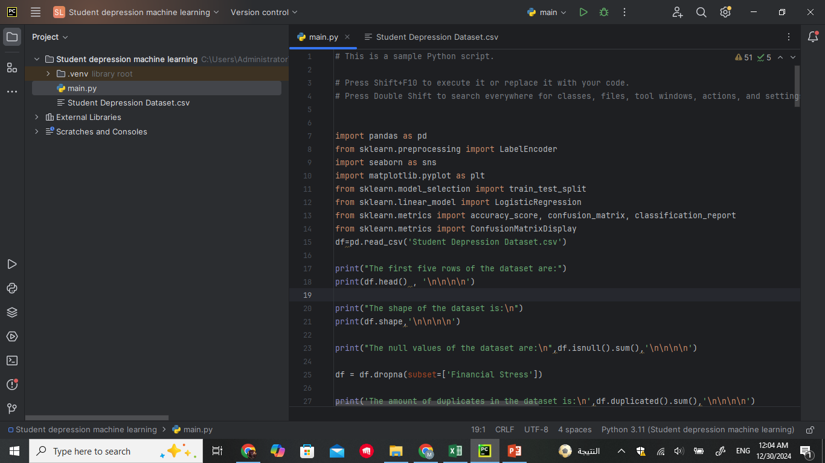

Libraries needed
For the required code to function properly we had to implement the following libraries
Numpy: To define x positions for the metrics.
Pandas: To be able to load and edit the data frame.
Sklearn.preprocessing: To be able to encode the none-numerical values in the data frame.
Seaborn: To be able to plot the correlation heat map.
Matplot.pyplot: To be able to plot the confusion matrix and the correlation heat map.
Sklearn.model_selection: To be able to split the dataset into training and testing sets.
Sklearn.linear_model: To be able to use the logistic regression model and train the sets.
Sklearn.metrics: To be able to compute accuracy score, confusion matrix and classification report as well as to plot the confusion matrix.
Sklearn.ensemble: To be able to use the random forest classification model and train the sets.
import numpy as np
from sklearn.ensemble import RandomForestClassifier

Slide 6
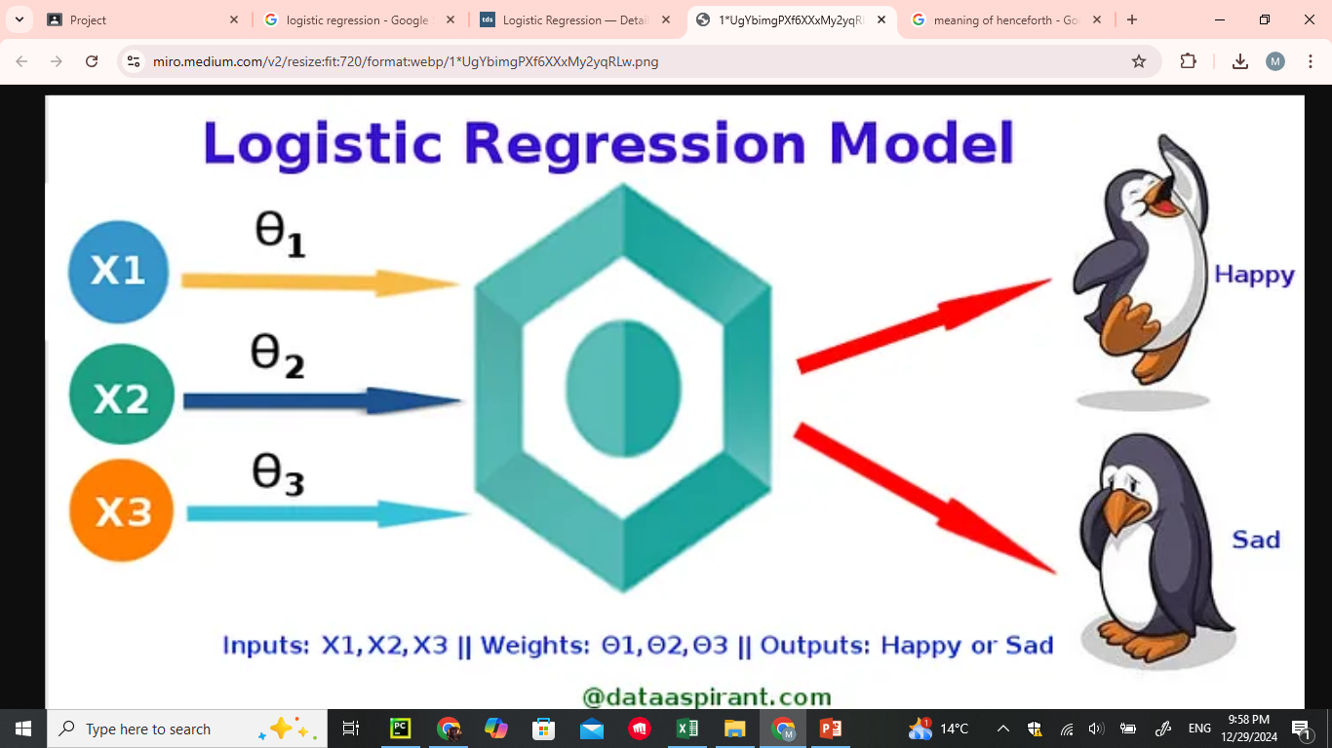
Algorithm 1
For this project we will be using Logistic Regression, a classification machine learning algorithm that uses sigmoid function to predict the probability that an instance belongs to a given class or not

Slide 7
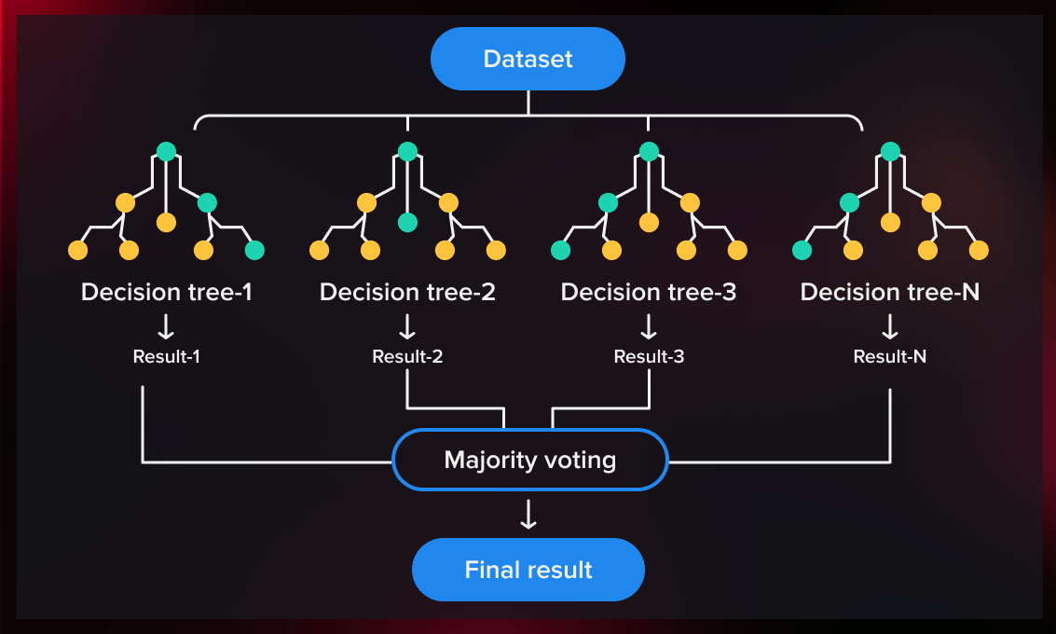
Algorithm
In addition to logistic regression we will also be using random forest classification ,another classification machine learning algorithm that creates an ensemble of multiple decision trees to reach a singular, more accurate prediction or result.

Slide 8

Why logistic regression?
Easy to implement and interpret results
Binary Classification Problem: The problem we’re solving—predicting whether a student is depressed or not—is a binary classification task. Logistic regression is designed specifically for this type of problem
Achieves maximum productivity with minimum wasted effort
Works well with smaller datasets.

Slide 9
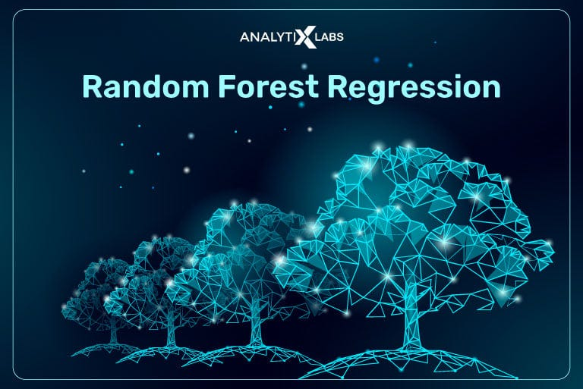
WHY RANDOM FOREST classification?
Reduces risks of overfitting and improves accuracy compared to a single tree.
Handles both classification and regression.
Handles missing values by estimating them using proximity-based methods within the forest.

Slide 10
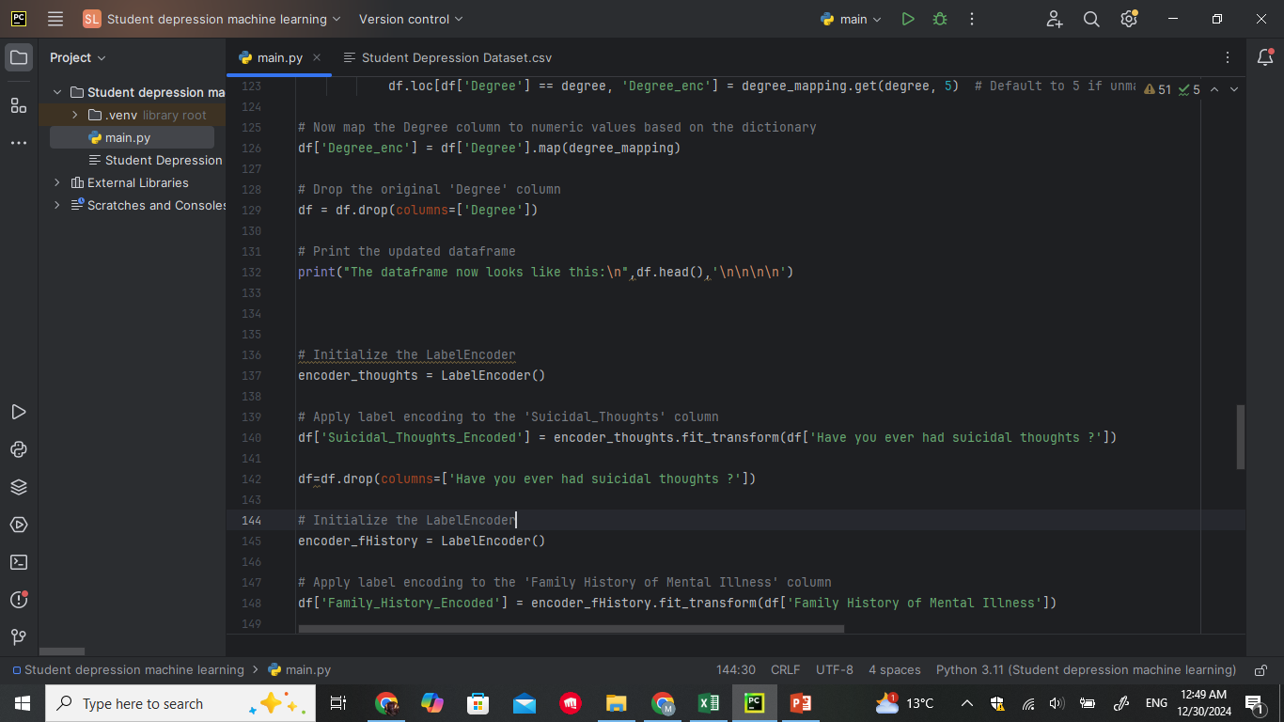
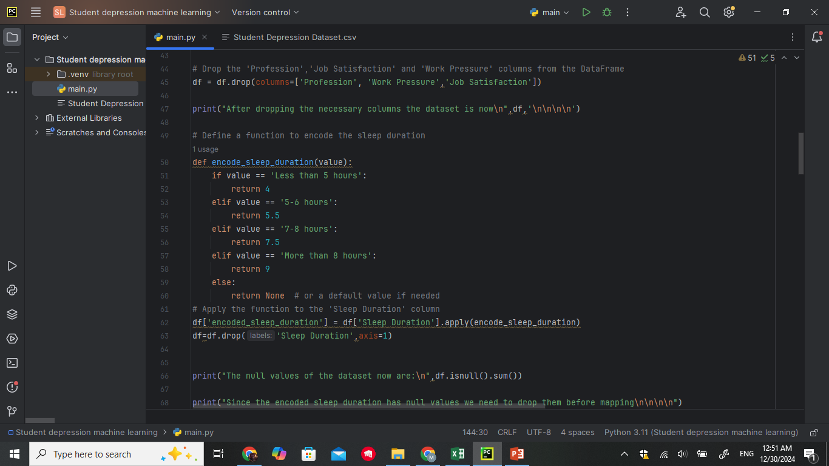
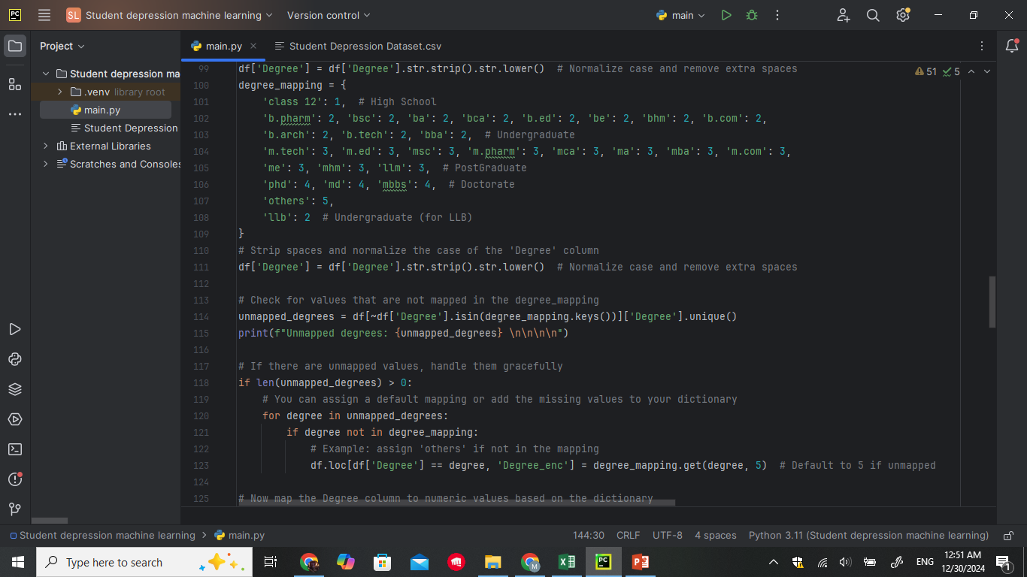
Encoding
To be able to train the model using the logistic regression model we need to turn the non-numerical values into binary using label encoder and the replace function. The columns were City , dietary habits , suicidal thoughts, gender, sleep duration, degree and family history.

Slide 11

Correlation
Some columns had a bad correlation so in order for the results to be accurate, dropping them was a necessity. Those columns were id ,gender ,city ,sleep duration and degree.
df=df.drop(columns=['id','Gender_enc','City_enc','encoded_sleep_duration','Degree_enc'])

Slide 12
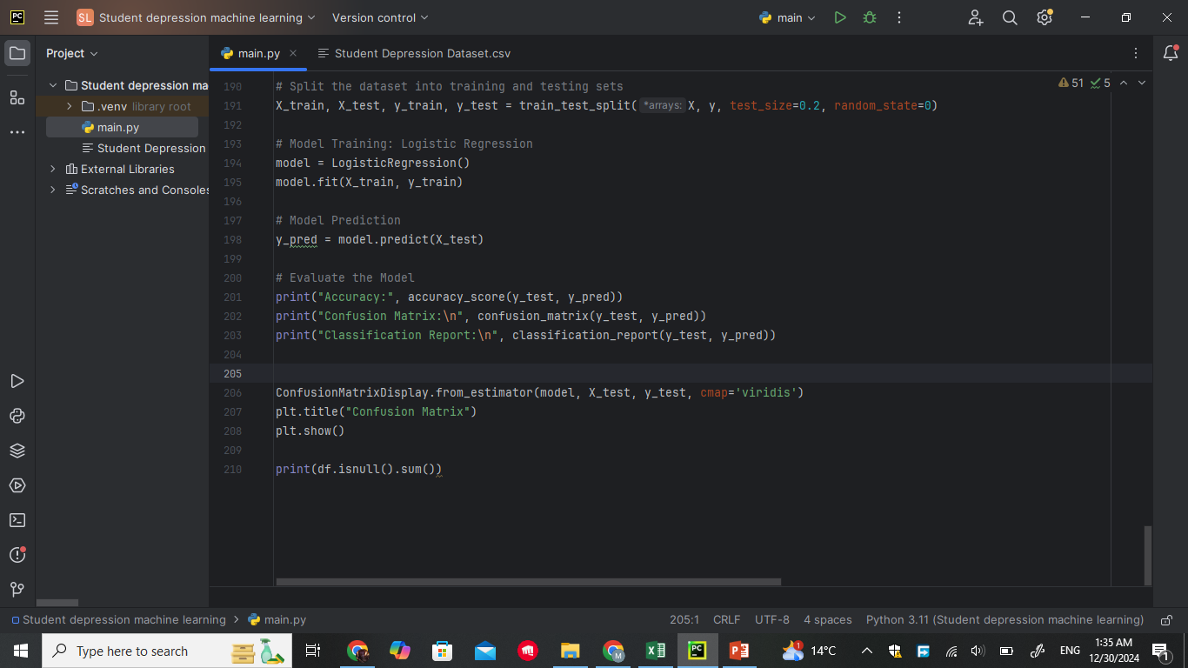

metrics
To evaluate the performance of the model we used the following metrics:
Accuracy: To check the overall model performance.
Confusion matrix: To check the strengths and weaknesses of the model
Classification report: For a view of precision, recall and f1_score for a better understanding

Slide 13
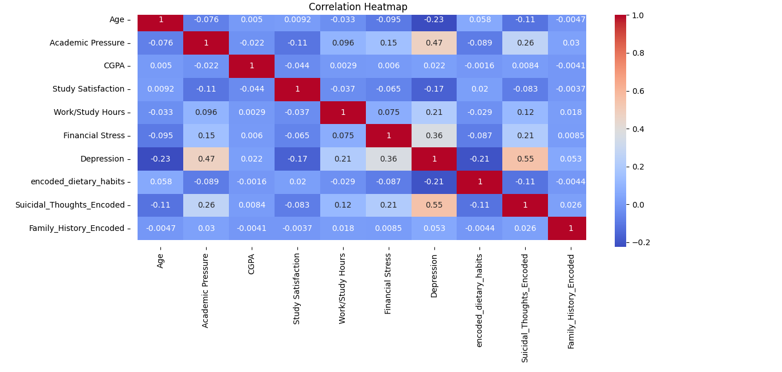
Correlation heat map

Slide 14
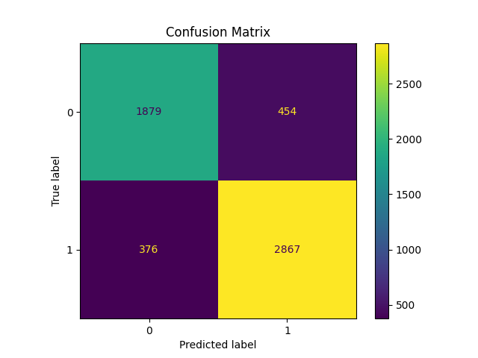
LOGISTIC Confusion matrix

Slide 15

Random forest classification confusion matrix

Slide 16
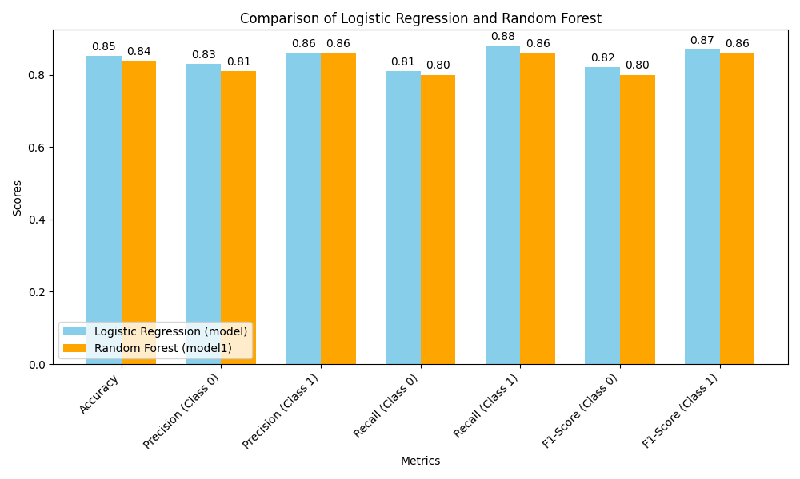
Logistic regression vs random forest classification

Slide 17

Self learning-outcome
Learned how to use logistic regression to predict models.
Learned how to use folium to create maps.
Learned about some python functions such as replace and apply.
Learned how to use seaborn to draw a heat map.

Slide 18

Recommendation
In order to potentially improve the model’s performance or extend the analysis further we can:
Test different preprocessing techniques and algorithm models.
Create more relative features that might represent the matter.
Expand the model to predict depression trends at a population level.

Slide 19

Thank You!
By Mahmoud zahra and Hiba shaito

